Slide 1

RETAIL EDGE
NEIL GOGTE INSTITUTE OF TECHNOLOGY
Kachavanisingaram Village, Hyderabad, Telangana 500058.
DEPARTMENT OF CSE(AIML)
PRESENTED BY :-
T.DEEKSHITA REDDY 245322748117
N.V.S.TEJASWI 245322748106
K.ADITHI REDDY 245322748090
UNDER THE GUIDANCE OF:-
Dr.T.SWATHI PRIYADARSHINI
ASSISTANT PROFESSOR

Slide 2
TABLE OF CONTENTS
INTRODUCTION
EXISTING SYSTEM
PROPOSED SYSTEM
WORKFLOW
OPERATING ENVIRONMENT
FUNCTIONAL REQUIREMENTS
SYSTEM DESIGN
SCREENSHOTS
FUTURE SCOPE
CONCLUSION

Slide 3
INTRODUCTION
In today's data-driven retail landscape, businesses need efficient ways to provide personalized shopping experiences and actionable insights, but traditional methods often rely on manual processes that can be time-consuming and lack scalability.
Our project introduces an advanced, AI-powered platform that uses RAG-enhanced technology to enhance the retail experience and streamline operations.
The solution is divided into three main components a customer experience module, a sales support module, and a mart owner analytics module.

Slide 4
EXISTING SYSTEM
The current retail systems would allow customer interactions to happen through old-fashioned search engines that possess prior preemptive keyword-based queries with which it does not comprehend the context of searches.
This becomes a lot of product discovery inefficiency, irrelevant results, and frustrating encounters for a customer.
Personalized recommendations are generally common and quite unresponsive to the new, real-time changes in preferences among customers.

Slide 5
LIMITATIONS
Current Retail Systems:
Customer interactions rely on outdated, keyword-based search engines.
These systems lack understanding of the context behind customer searches.
Product Discovery:
Inefficient product discovery due to limited search capabilities.
High potential for irrelevant search results, leading to customer frustration.
Lack of Real-Time Personalization:
Personalized recommendations are often static and unresponsive.
Limited adaptability to new, real-time changes in customer preferences.

Slide 6
PROPOSED SYSTEM
The system leverages a RAG-enhanced model for efficient data retrieval which can answer user queries and visualization tool to generate accurate, insightful graphs and charts.
We are creating a user-friendly interface that allows retail managers and salespersons to upload data files and instantly receive insights through clear data visualizations.
By using advanced AI and language models, our platform delivers high accuracy and relevancy in the insights provided, improving decision-making and operational efficiency in retail.

Slide 7
ADVANTAGES OF PROPOSED SYSTEM
Customer Experience: By using sophisticated NLP and RAG, the output about any product under search would be correct for the customer.
Associate Tools: The associate user interface will enable data visualization by branch in addition to an overview, so the associate can quickly see trends and performance at specific retail units.
Chatbot Integration: Our system seamlessly combines NLP to enhance the output of the bot, serving accurate, contextually relevant responses by referencing an external knowledge base without retraining.

Slide 8
FEATURES
Customer Interface:
Search Capability
Associate Interface:
Branch wise data visualization
Overall data visualization
Owner Interface:
Branch wise and overall data visualization
RAG implemented Chatbot

Slide 9
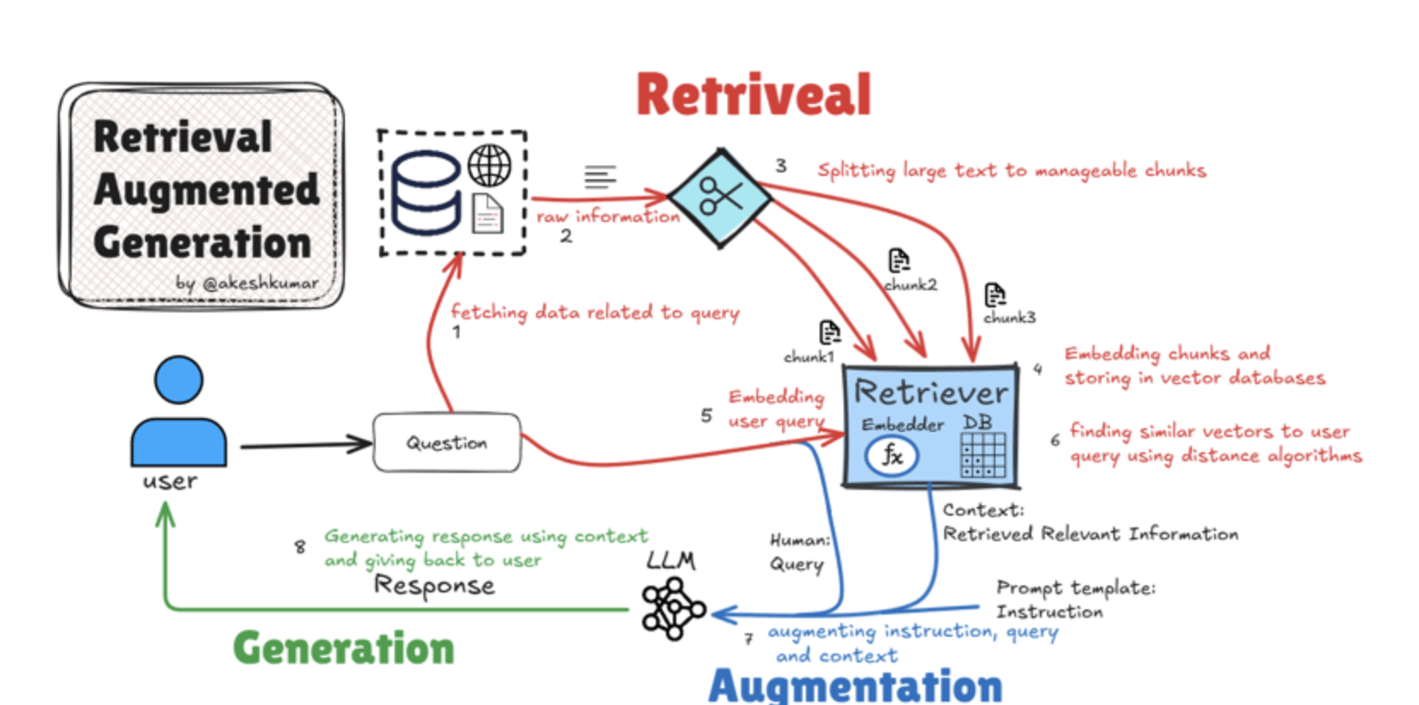
ARCHITECTURE

Slide 10
OPERATING ENVIRONMENT
Software Requirements:
Operating System : Windows 7 (Min)
Front End : Streamlit
Back End : Python
Database : MongoDB
Hardware Requirements:
Processor : Intel Pentium® Dual Core Processor (Min)
Speed : 2.9 GHz (Min)
RAM : 4 GB (Min)
Hard Disk : 10 GB (Min)

Slide 11
FUNCTIONAL REQUIREMENTS
User Functionality:
Customer Interface:
Search Capability: Customers can perform intuitive searches for products, with results tailored to their queries and preferences.
Associate Interface:
Branch-wise Data Visualization: Associates can view visualizations specific to their branch, providing insights into stock and sales trends.
Overall Data Visualization: Associates can also access overall data visualizations, allowing them to compare their branch performance with others.
Owner Interface:
Chatbot: An AI chatbot provides owners with retail insights, answering queries about product performance, trends, and other retail-related questions.

Slide 12
FUNCTIONAL REQUIREMENTS
Admin Functionality:
The admin manages the website.
The admin can increase database size.
The admin can make changes to the website such as modifying the UI and making it more interactive than earlier.
The admin can implement a better algorithm if at all a better algorithm is created in near future.

Slide 13
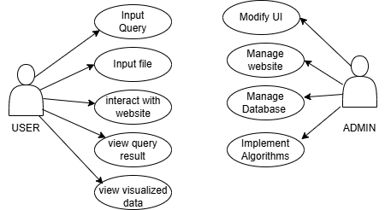
USE CASE DIAGRAM:
SYSTEM DESIGN

Slide 14
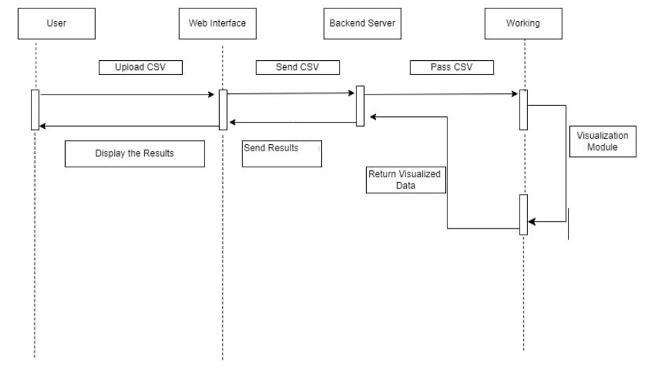
SEQUENCE DIAGRAM:
Visualization Model

Slide 15
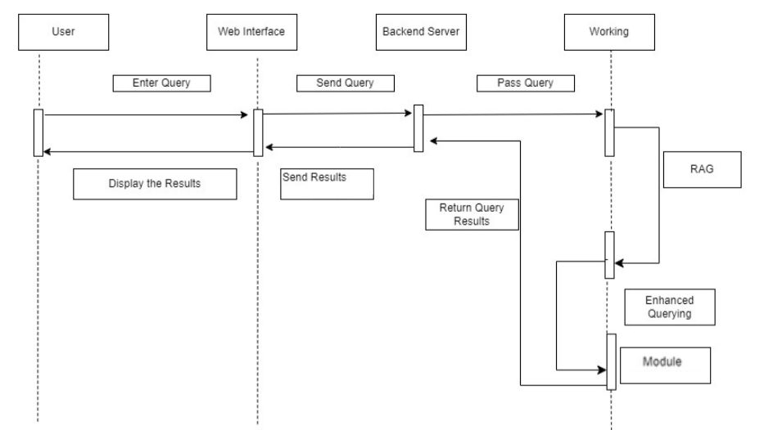
SEQUENCE DIAGRAM:
Query Model

Slide 16
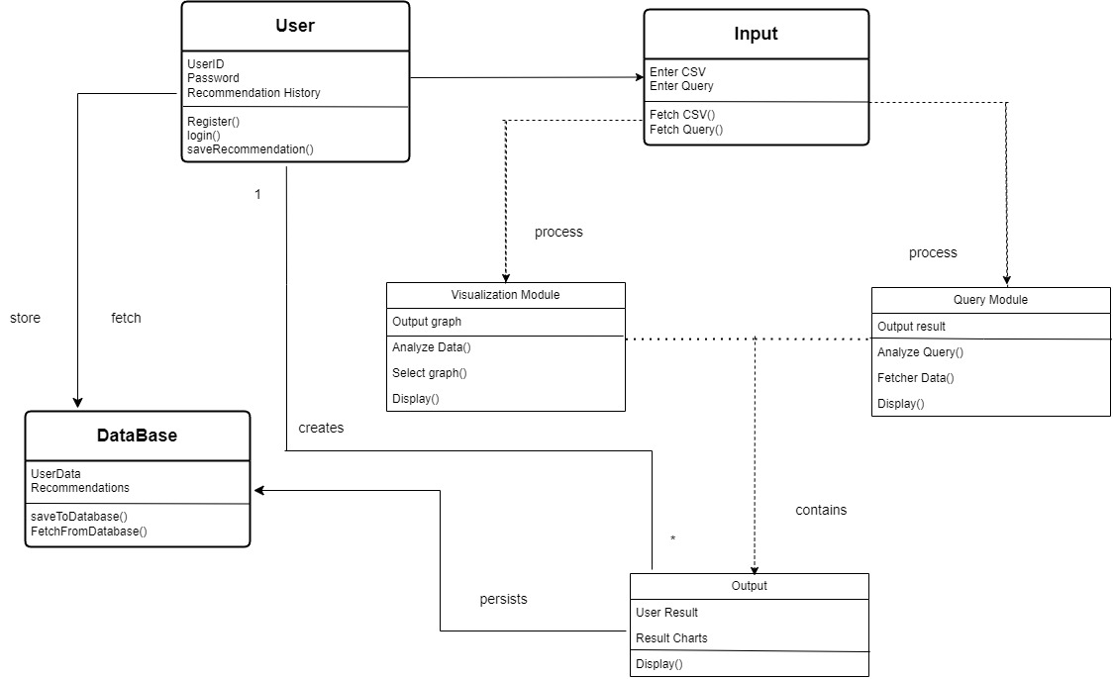
CLASS DIAGRAM

Slide 17
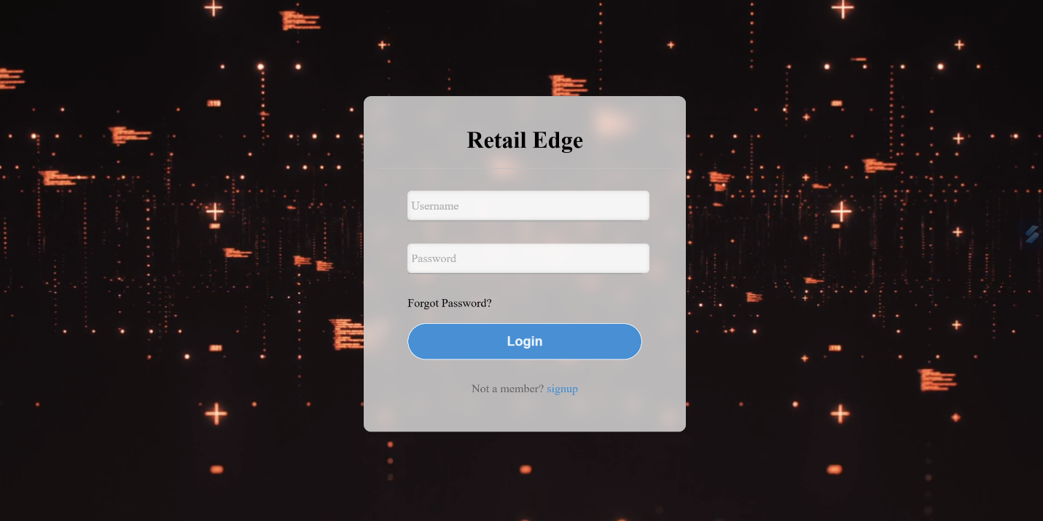
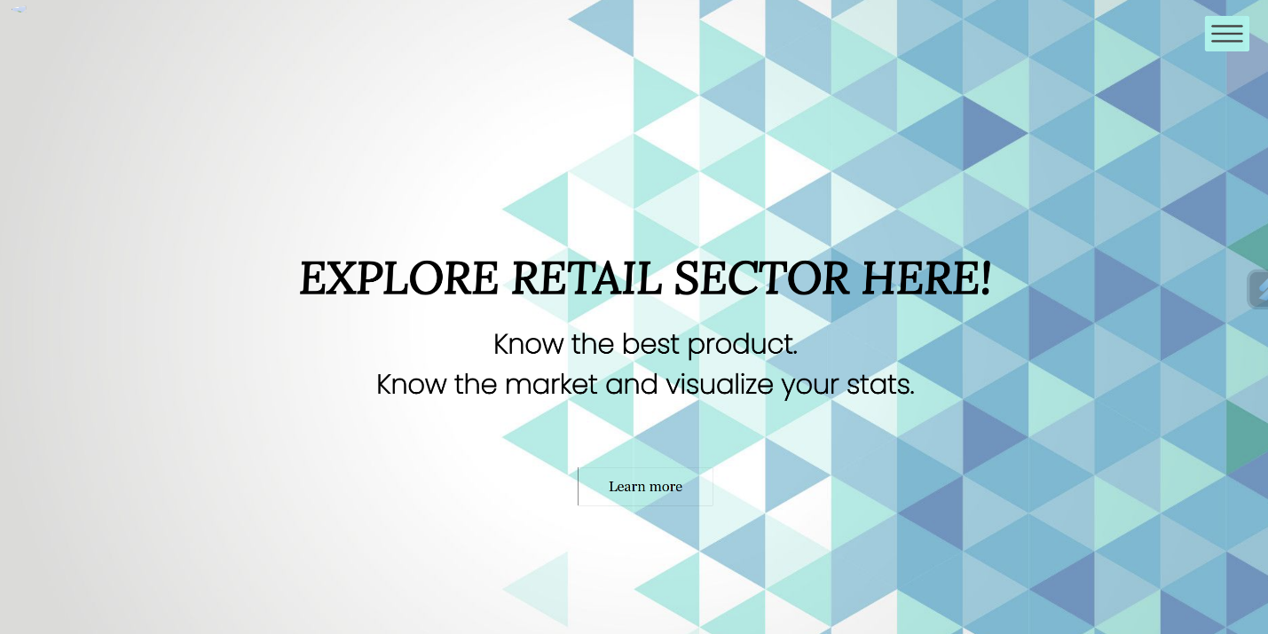
RESULTS(SCREENSHOTS)
Login
Home

Slide 18
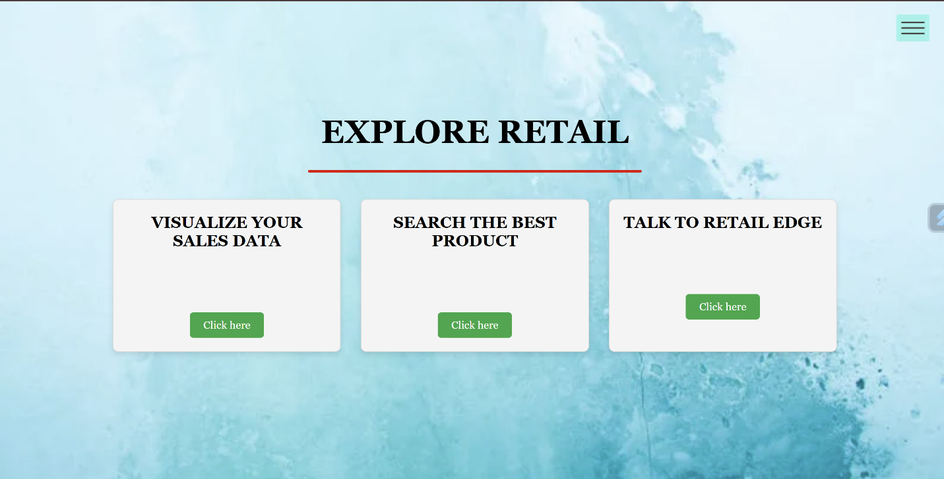
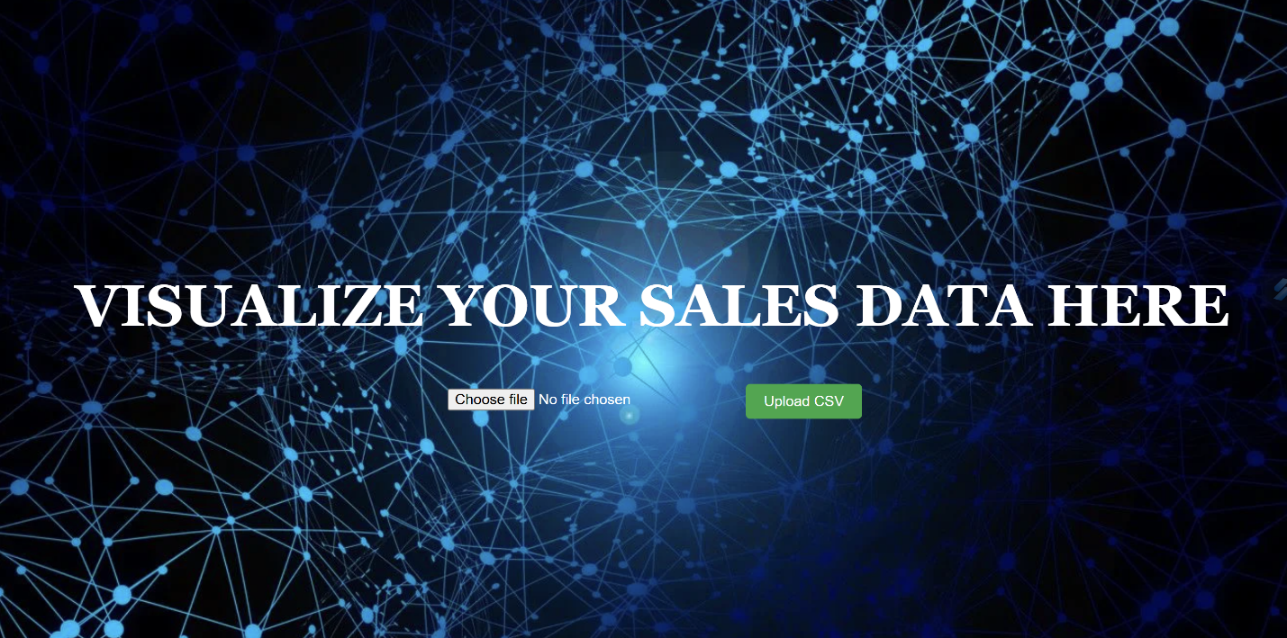
RESULTS(SCREENSHOTS)
Input
Visualize your sales data

Slide 19
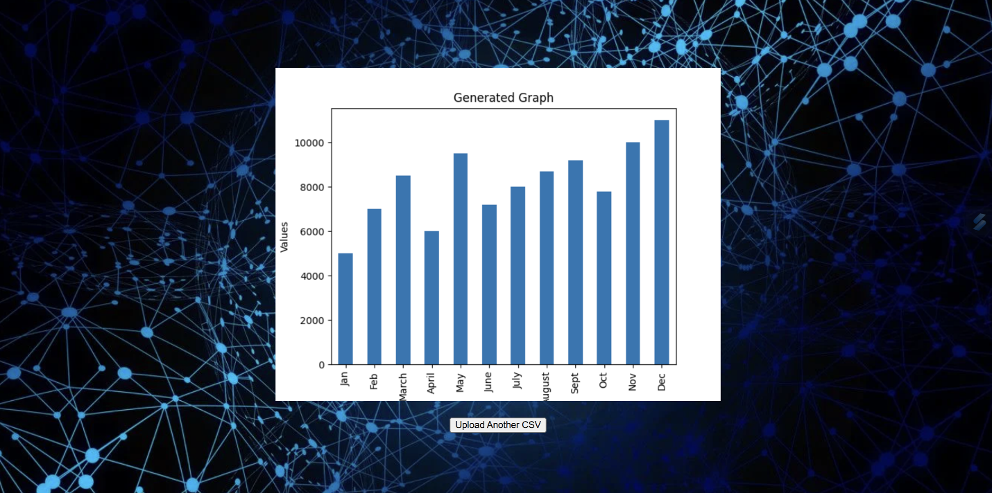
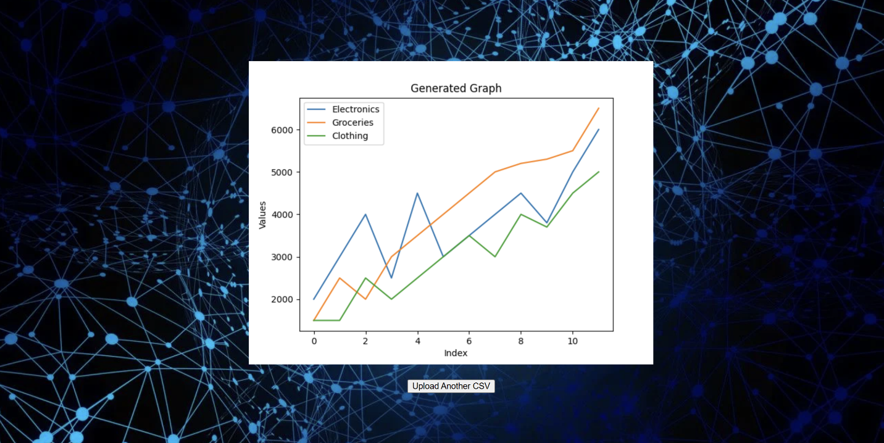
RESULTS(SCREENSHOTS)
Visualization for branch wise data
Visualization for overall data

Slide 20
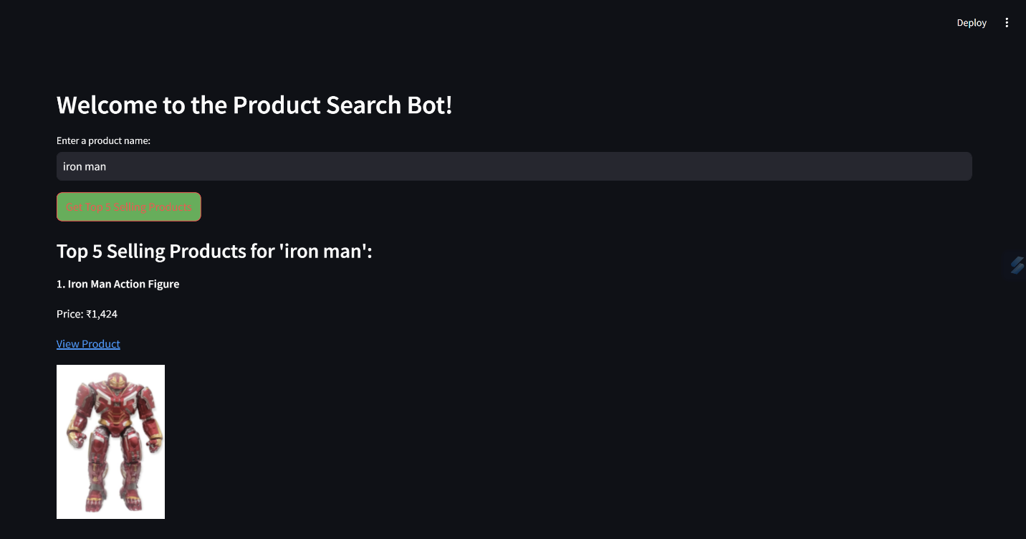
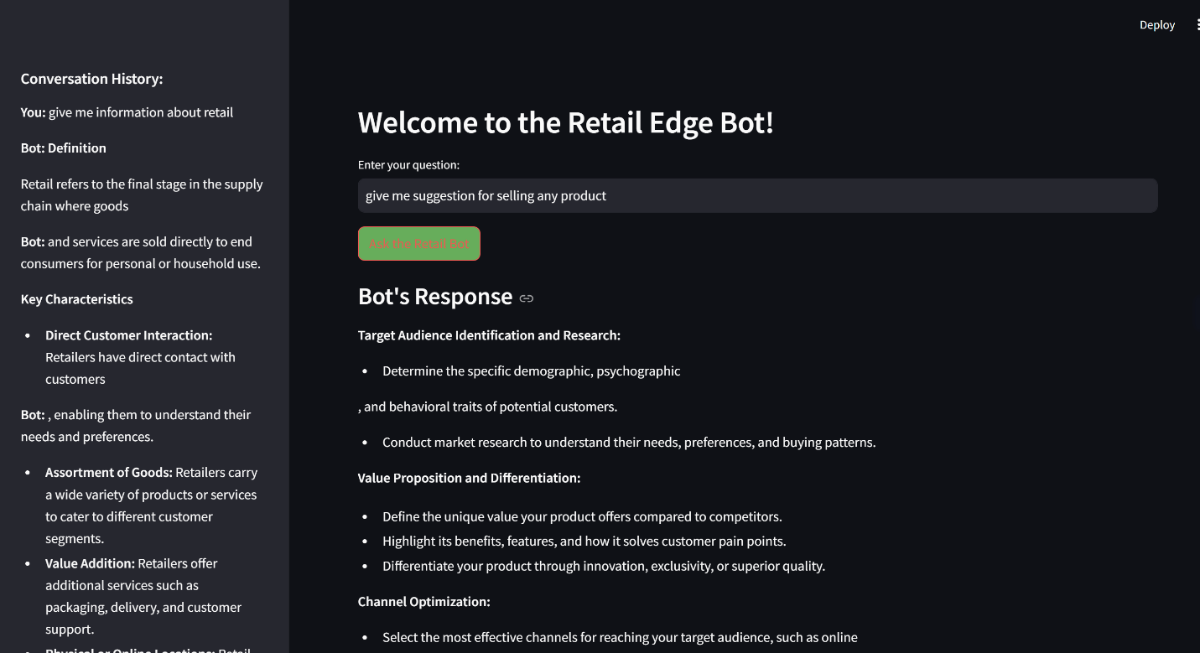
RESULTS(SCREENSHOTS)
Search best product
Talk to Retail Edge

Slide 21
FUTURE SCOPE
Integration with IoT Devices: Use IoT-enabled devices to track inventory in real-time and automate stock updates.
Multilingual Support: Expand the system to support queries and interactions in multiple languages to cater to a global user base.
Advanced Analytics: Introduce predictive analytics to anticipate customer needs, forecast sales, and identify market trends.
Dynamic Personalization: Develop adaptive algorithms to provide real-time personalization based on customer preferences and behaviour.
Mobile Application: Extend the platform to a mobile application for easier access and wider reach.

Slide 22
CONCLUSION
The Retail Edge successfully integrates advanced AI technologies like Retrieval-Augmented Generation (RAG) to address key challenges in the retail industry.
By streamlining customer interactions, providing actionable insights to associates, and enabling data-driven decision-making for mart owners, the system offers a holistic solution to enhance retail efficiency and profitability.
The user-centric design, secure data handling, and scalable architecture make it a reliable and robust platform that not only improves operational workflows but also fosters customer satisfaction and business growth.
This project demonstrates the potential of AI-powered solutions to redefine retail processes and drive innovation in the industry.

Slide 23
Thank You

